Slide 1

Organized Globally, Held Locally
Art of Beautiful Power BI Reports Themes, Colors and Backgrounds
Denis Molodtsov

Slide 2

Why Design Matters

Slide 3


Denis Molodtsov
My name is Denis Molodtsov, and I’ve been working with Microsoft 365 for over a decade. I live here in Toronto
And as you’ll in this session, I love automating everything.

Slide 4
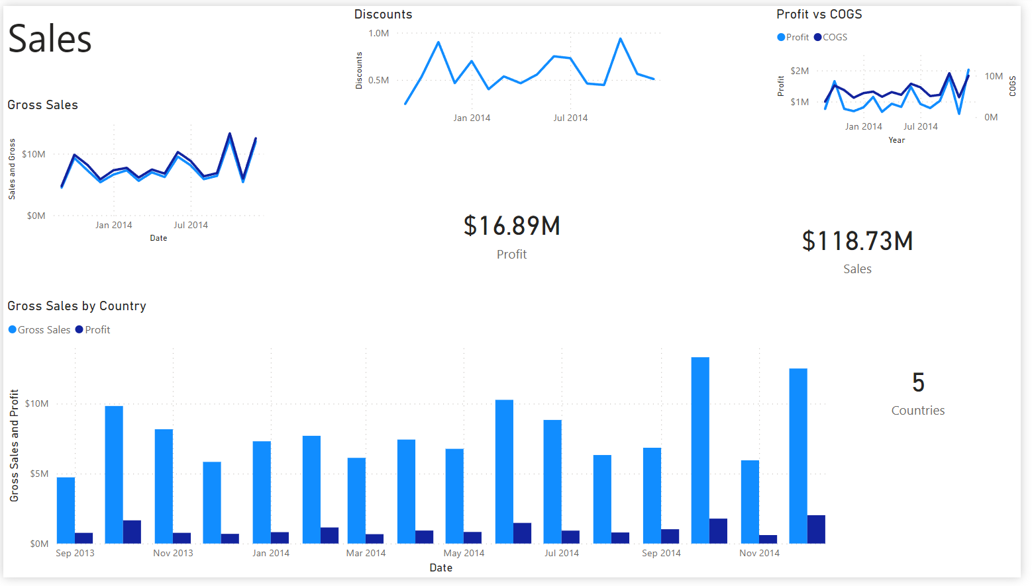
What we shall start with

Slide 5
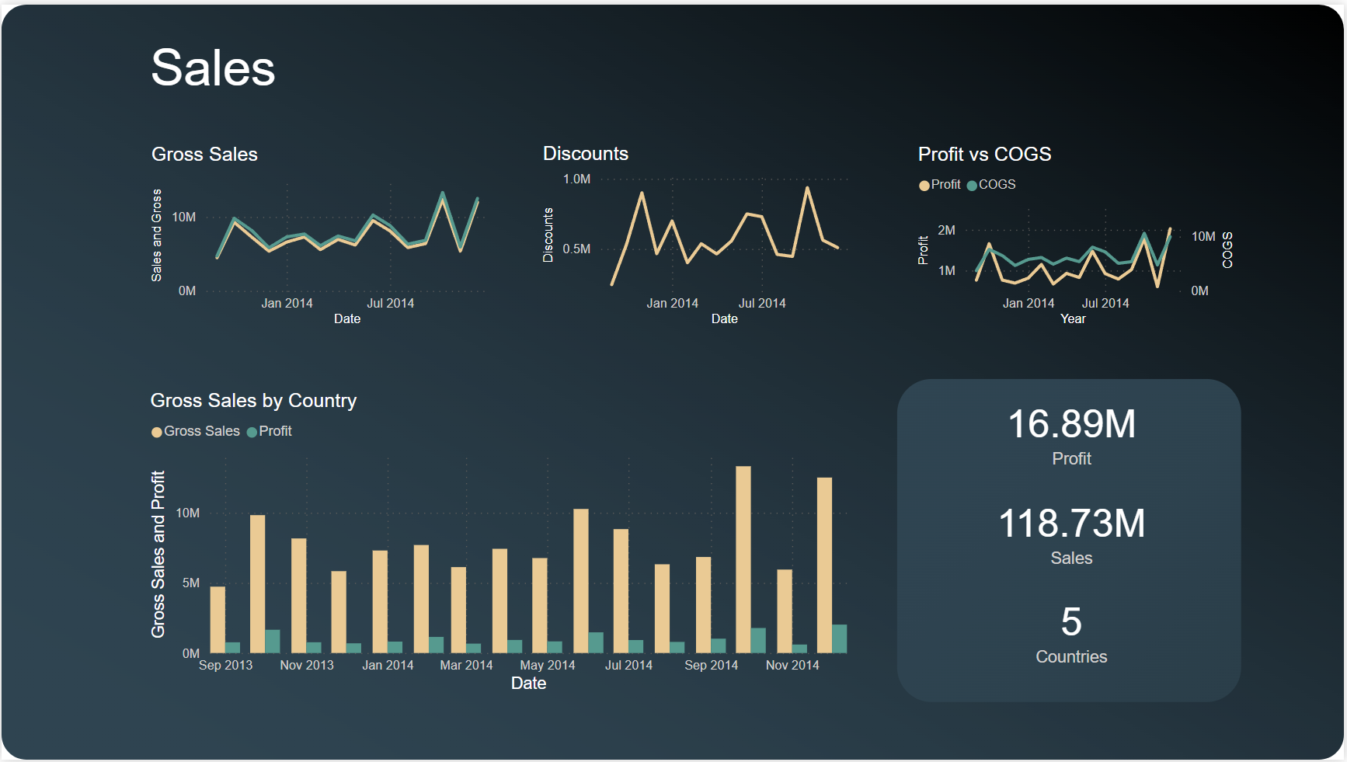

Slide 6
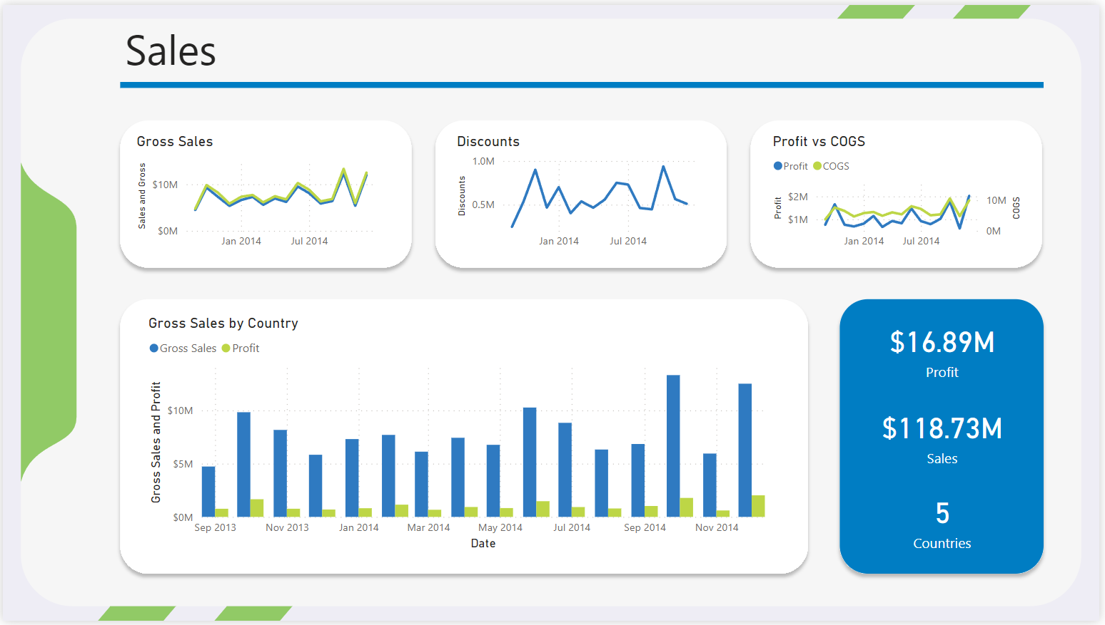

Slide 7
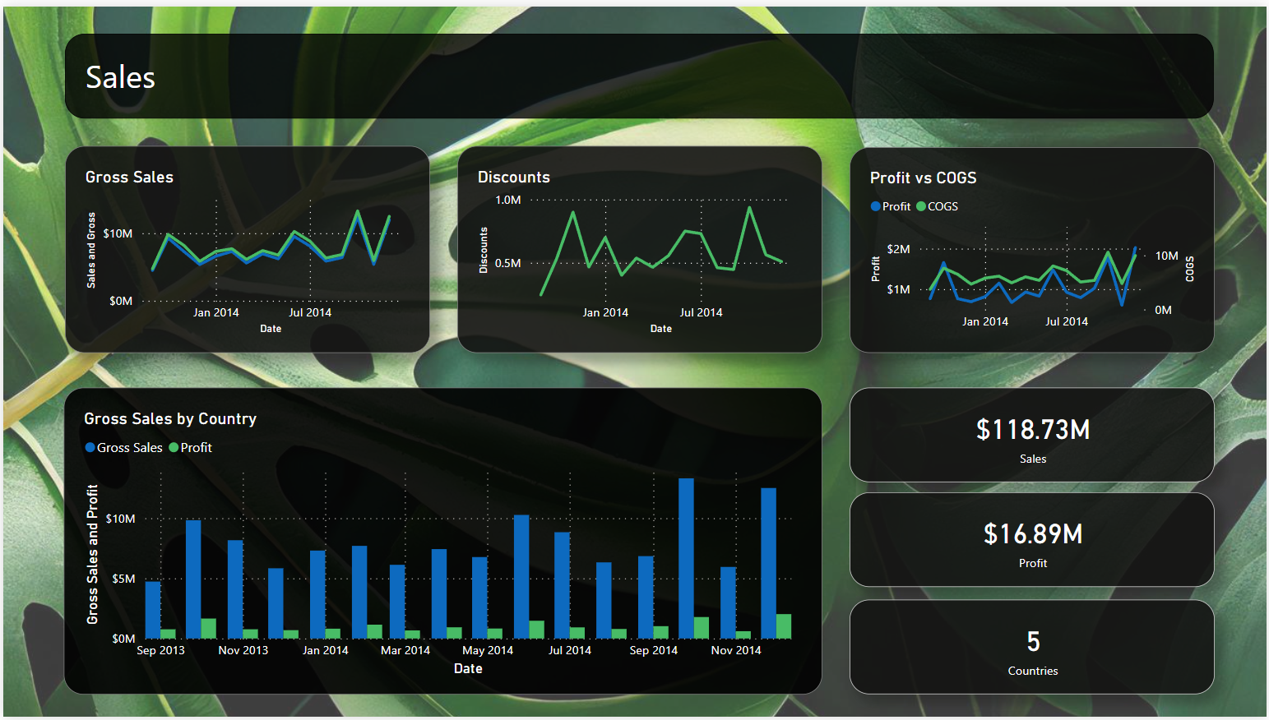

Slide 8
Agenda
🎓 General Design rules
🎬 Demo
🖼️ Backgrounds
🎨 Themes

Slide 9

Breathing Space

Slide 10
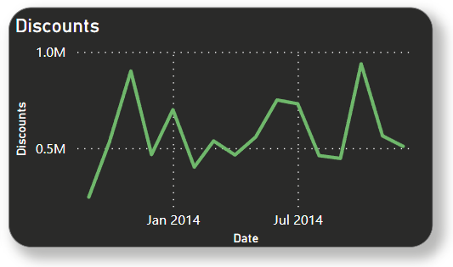
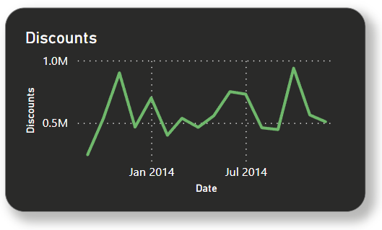
Padding
😐
😀

Slide 11
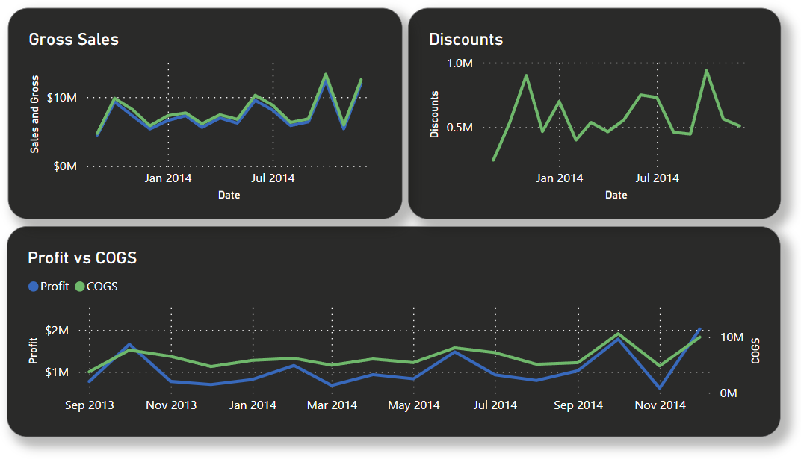
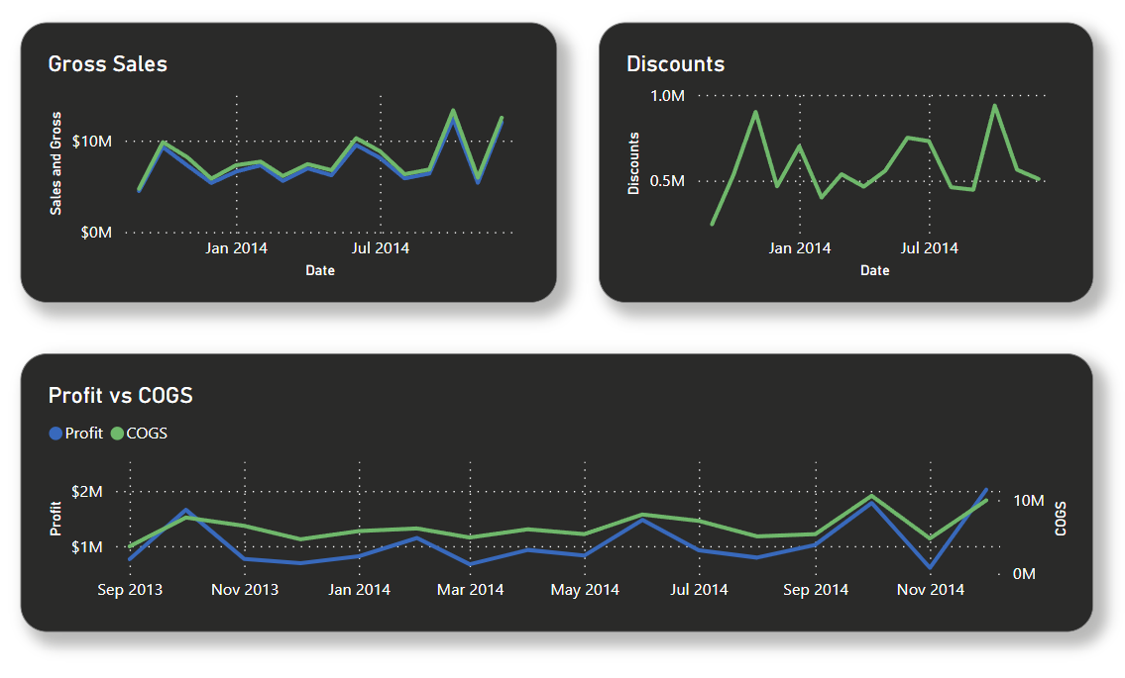
Margins
😐
😀

Slide 12
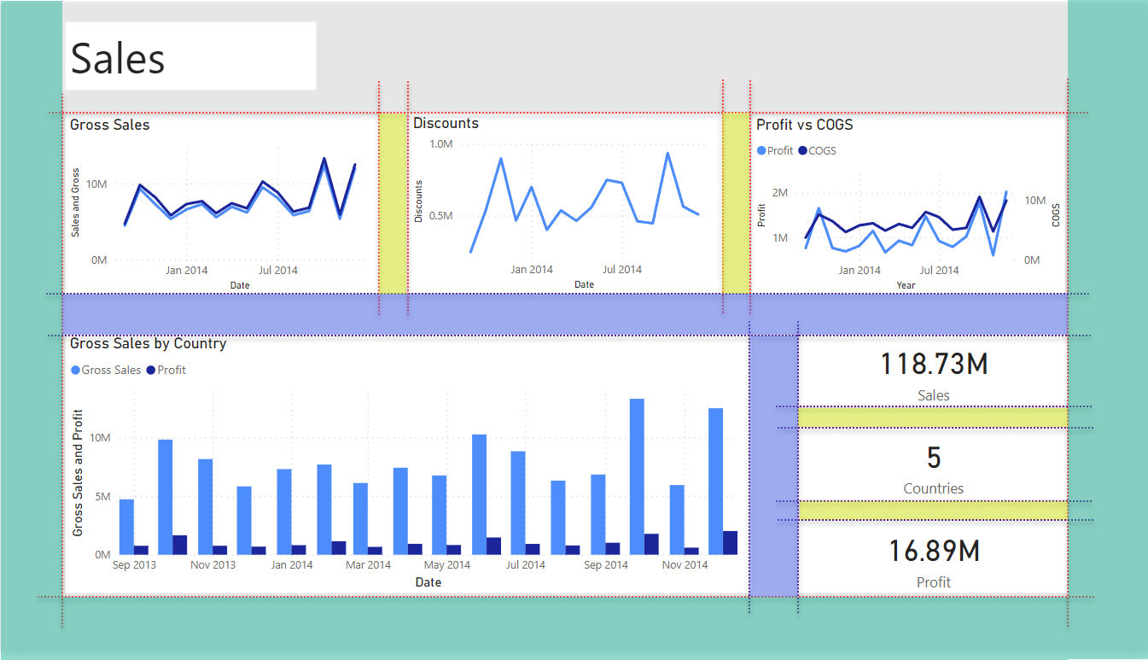

Slide 13
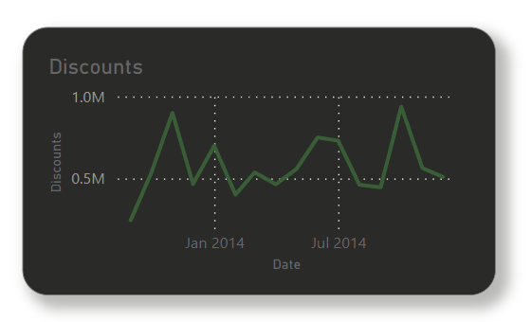
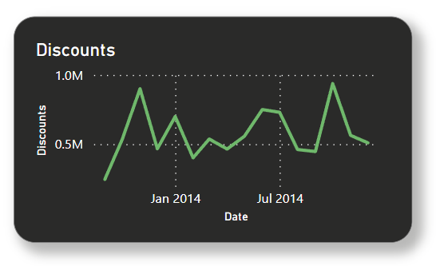
Contrast and Readability
😐
😀

Slide 14
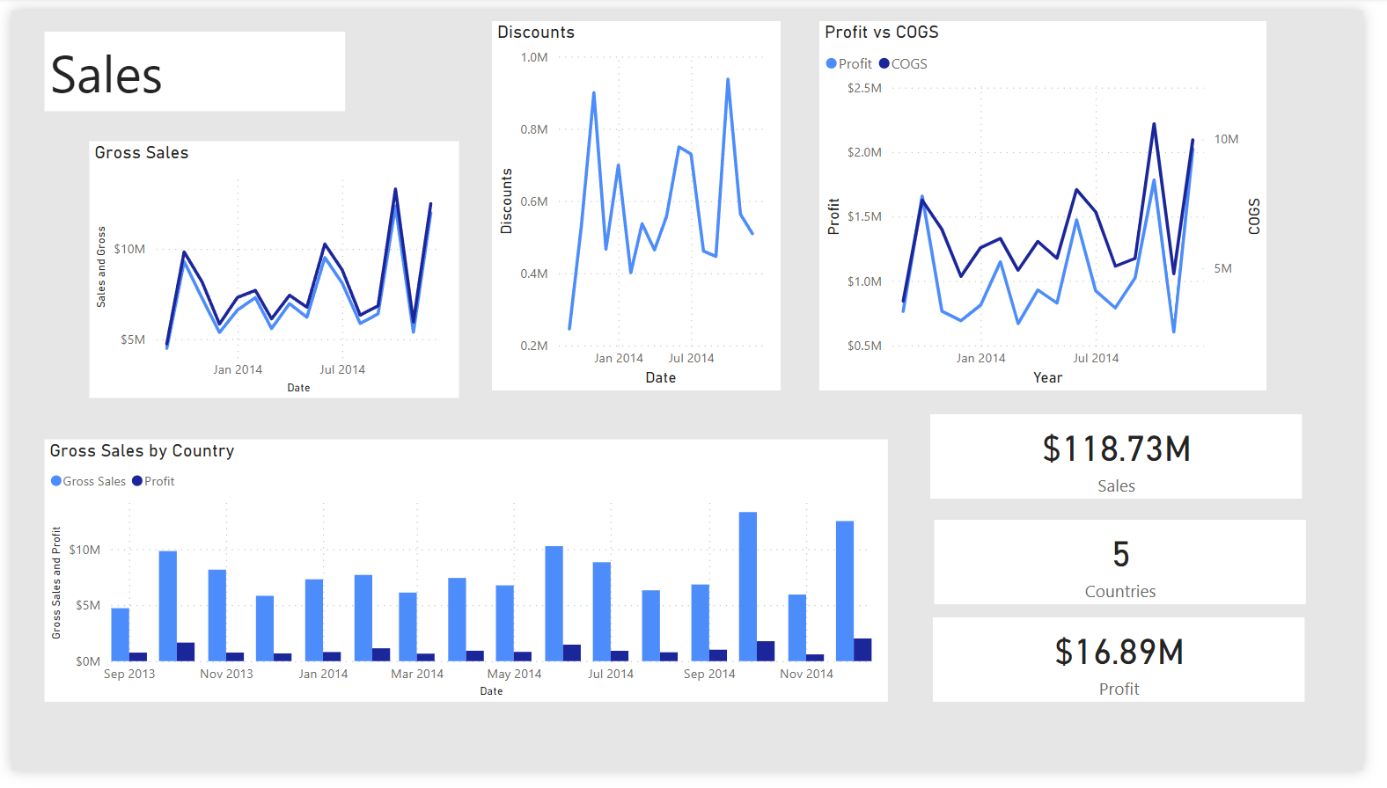
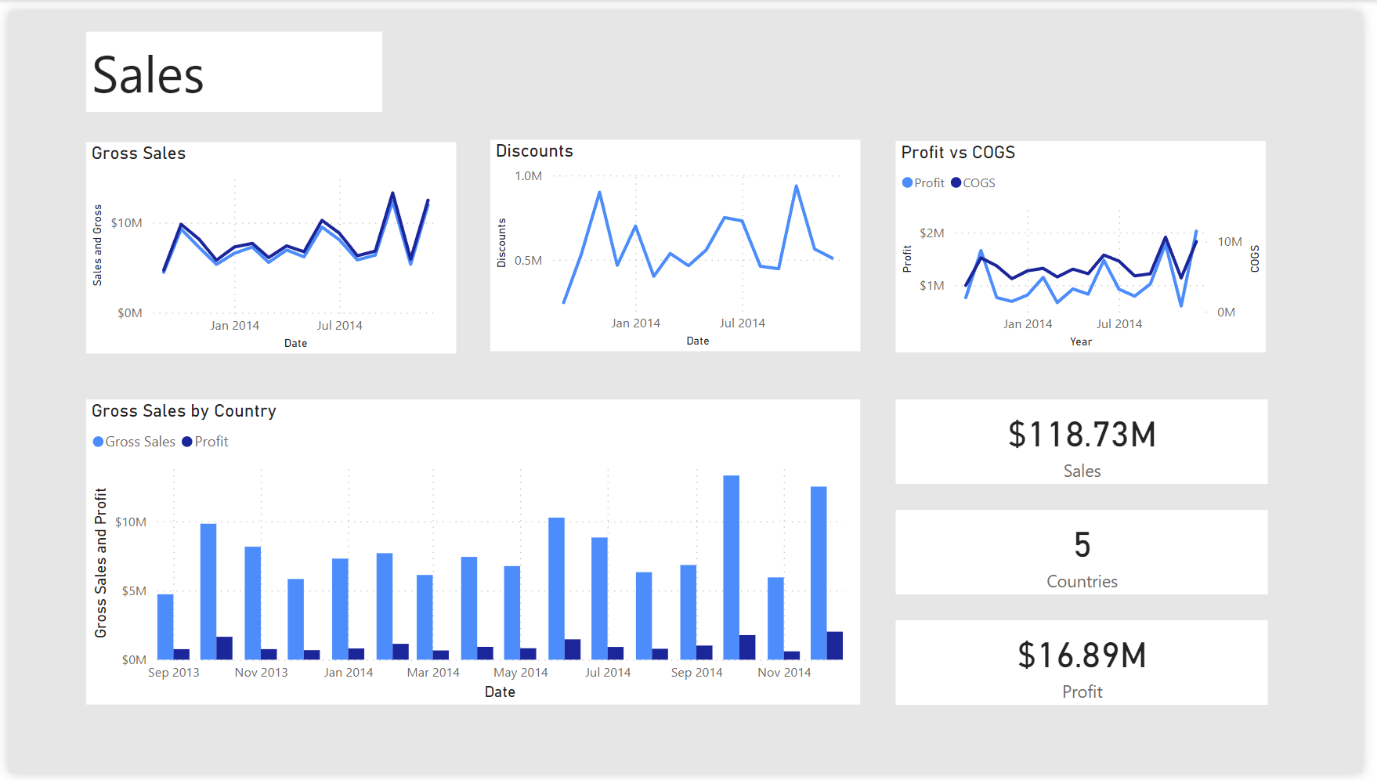
Alignment
😐
😀

Slide 15
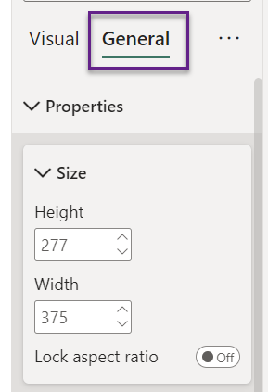
Set identical size for similar visuals

Slide 16
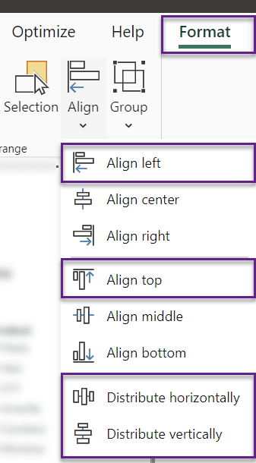
Align visuals

Slide 17
Demo

Slide 18
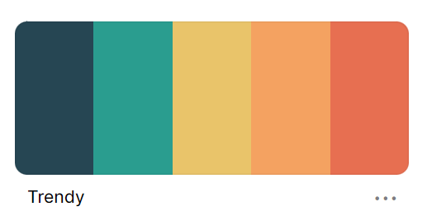
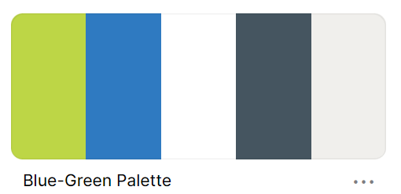
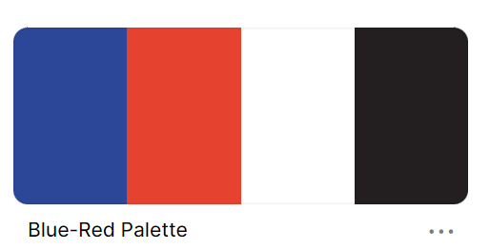

Slide 19
Any Questions?

Slide 20

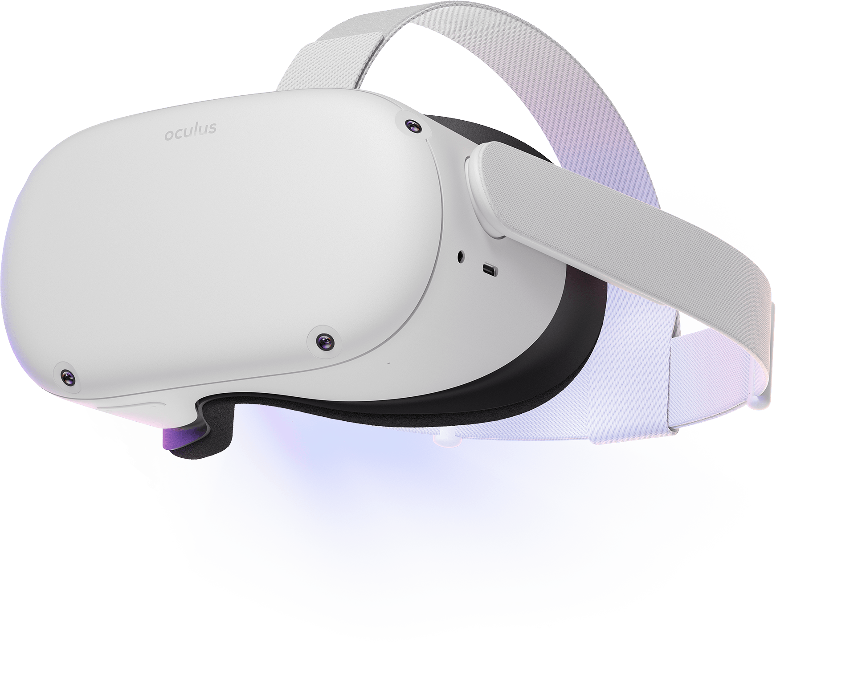


Please fill out the survey! & Win Swags!!
https://bit.ly/GPPBSurvey
Powered By

Slide 21

Platinum Sponsor
Thanks To Our Sponsor’s
Local Sponsors

Slide 22
Thank you
Resources:
Coolors
Power BI Backgrounds
Power BI Theme Templates
Power BI Theme Generator
Sample Power BI Reports from this presentation

